Slide 1
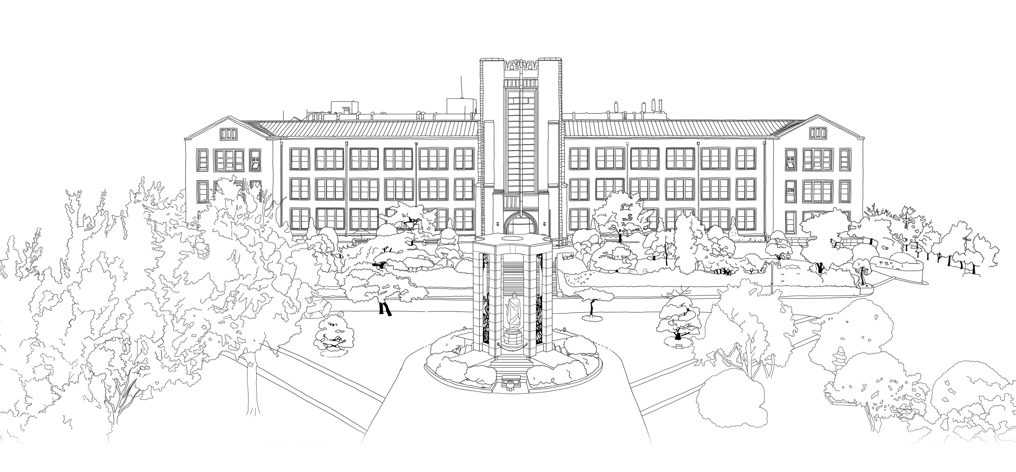


Introduction to Algorithms
DongYeon Kim
Department of Multimedia Engineering
Dongguk University

Slide 2
Contents
Chapter.3 Data Structures
Elementary Data Structures
Stacks and queues
Linked lists
Implementing pointers and objects
Representing rooted trees
Hash Tables
Direct-address tables
Hash tables
Hash functions
Open addressing
Perfect hashing
Binary Search Trees
What is a binary search tree?
Querying a binary search tree
Insertion and deletion
Randomly built binary search trees
Red-Black Trees
Properties of red-black trees
Rotations
Insertion
Deletion
Augmenting Data Structures
Dynamic order statistics
How to augment a data structure
Interval trees

Slide 3
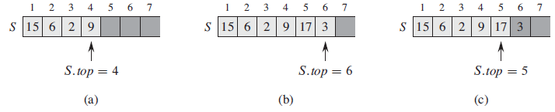
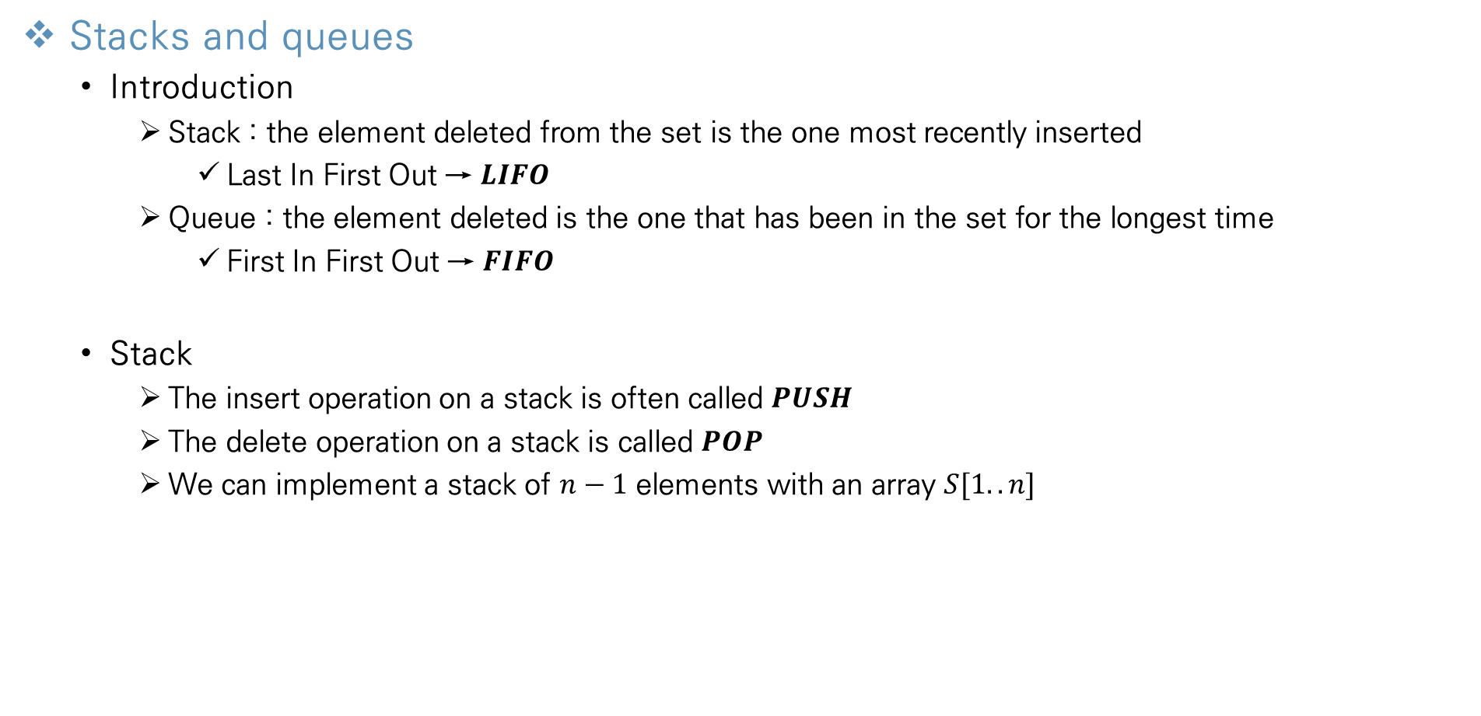
Elementary Data Structures
Stacks and queues
Introduction
Stack : the element deleted from the set is the one most recently inserted
Last In First Out → $LIFO$
Queue : the element deleted is the one that has been in the set for the longest time
First In First Out → $FIFO$
Stack
The insert operation on a stack is often called $PUSH$
The delete operation on a stack is called $POP$
We can implement a stack of $n−1$ elements with an array $S[1..n]$

Slide 4
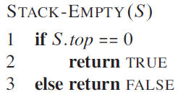
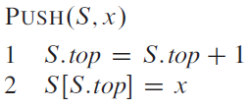
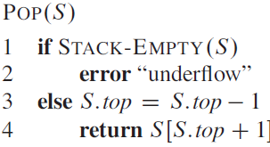
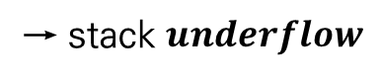
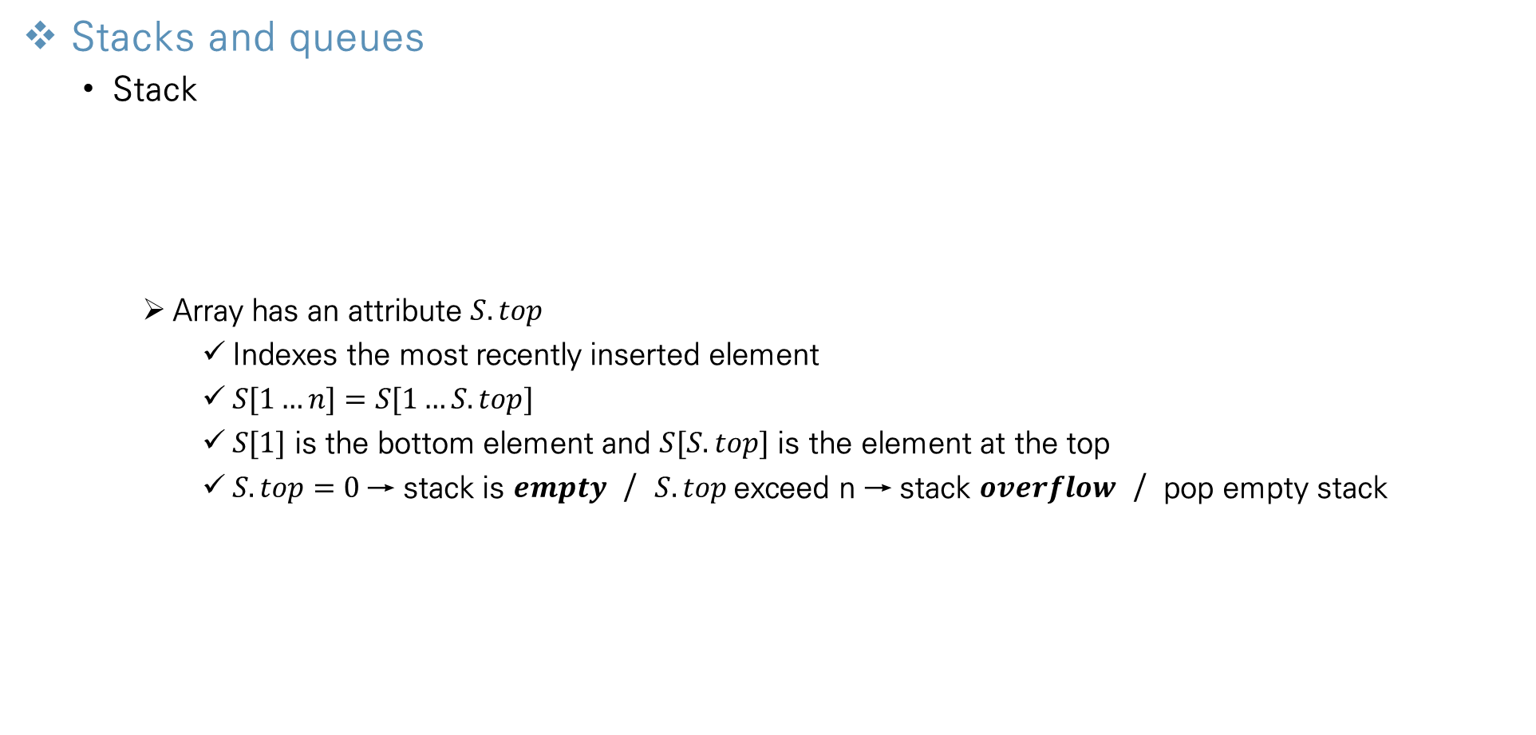
Elementary Data Structures
Stacks and queues
Stack
Array has an attribute $S.top$
Indexes the most recently inserted element
$S[1…n]=S[1…S.top]$
$S[1]$ is the bottom element and $S[S.top]$ is the element at the top
$S.top=0$→ stack is $empty$ / $S.top$exceed n → stack $overflow$ / pop empty stack
→ stack $underflow$
→ each stack operation takes O(1) times

Slide 5
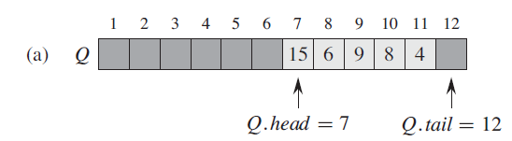
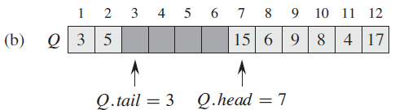
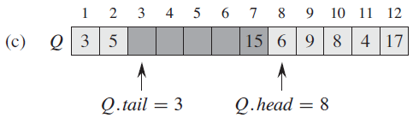
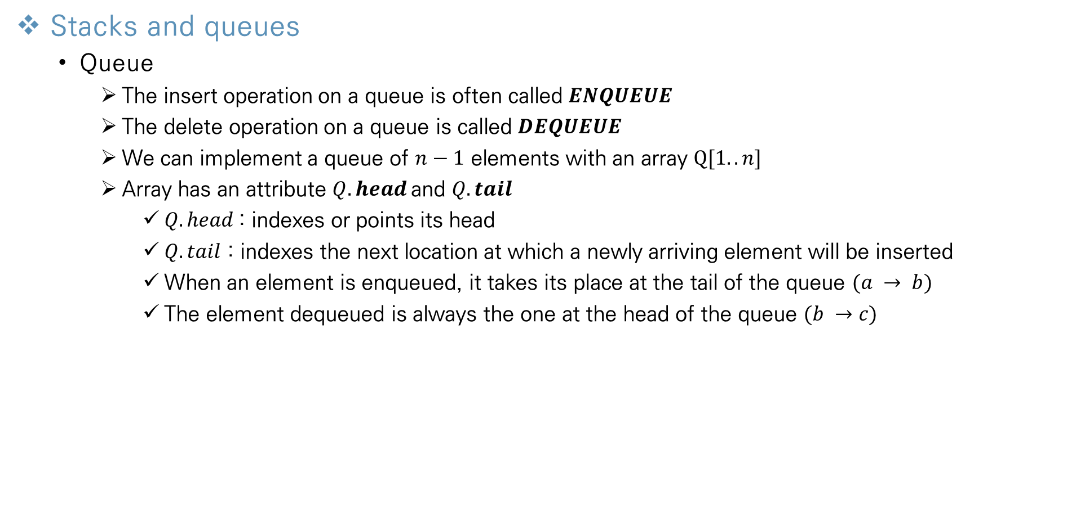
Elementary Data Structures
Stacks and queues
Queue
The insert operation on a queue is often called $ENQUEUE$
The delete operation on a queue is called $DEQUEUE$
We can implement a queue of $n−1$ elements with an array $Q[1..n]$
Array has an attribute $Q.head$and $Q.tail$
$Q.head$: indexes or points its head
$Q.tail$ : indexes the next location at which a newly arriving element will be inserted
When an element is enqueued, it takes its place at the tail of the queue $(a → b)$
The element dequeued is always the one at the head of the queue $(b →c)$

Slide 6
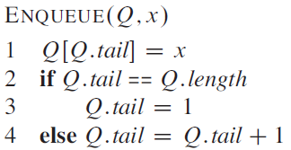
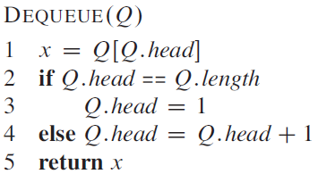

Elementary Data Structures
Stacks and queues
Queue
We can implement queue using “wrap around” method
Location $n$ immediately follows location 1 in a circular order
The elements in the queue reside in locations $Q.head, Q.head+1, .. , Q.tail−1$
When $Q.head = Q.tail$, the queue is empty
If we attempt to dequeue an element from an empty queue the queue $underflows$
When $Q.head = Q.tail+1$, the queue is full
If we attempt to enqueue and element, then the queue $overflows$
→ each queue operation takes O(1) times

Slide 7
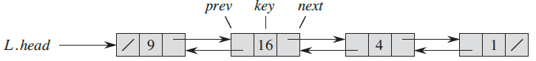
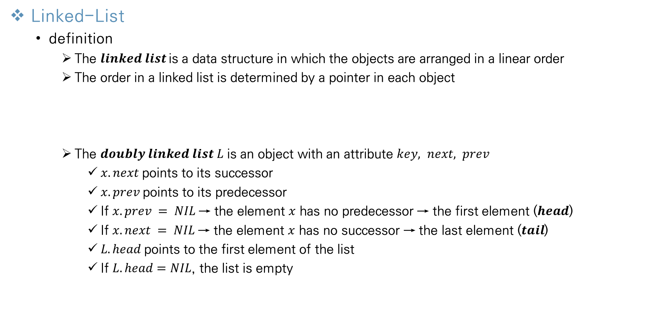
Elementary Data Structures
Linked-List
definition
The $linked list$is a data structure in which the objects are arranged in a linear order
The order in a linked list is determined by a pointer in each object
The $doubly linked list L$ is an object with an attribute $key, next, prev$
$x.next$points to its successor
$x.prev$points to its predecessor
If $x.prev = NIL$→ the element $x$ has no predecessor → the first element ($head$)
If $x.next = NIL$→ the element $x$ has no successor → the last element ($tail$)
$L.head$points to the first element of the list
If $L.head=NIL$, the list is empty

Slide 8
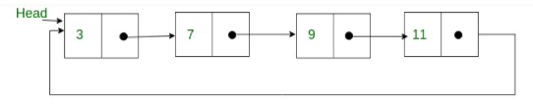
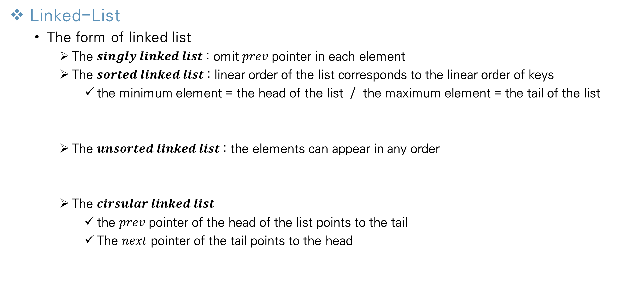
Elementary Data Structures
Linked-List
The form of linked list
The $singly linked list$ : omit $prev$ pointer in each element
The $sorted linked list$ : linear order of the list corresponds to the linear order of keys
the minimum element = the head of the list / the maximum element = the tail of the list
The $unsorted linked list$ : the elements can appear in any order
The $cirsular linked list$
the $prev$ pointer of the head of the list points to the tail
The $next$ pointer of the tail points to the head

Slide 9
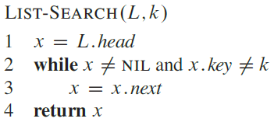
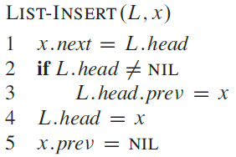
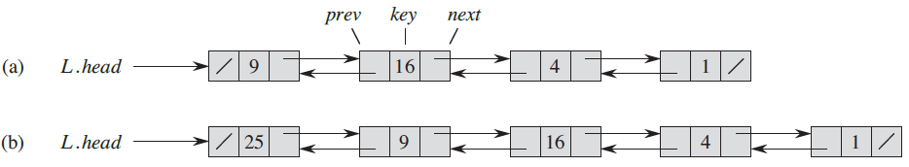
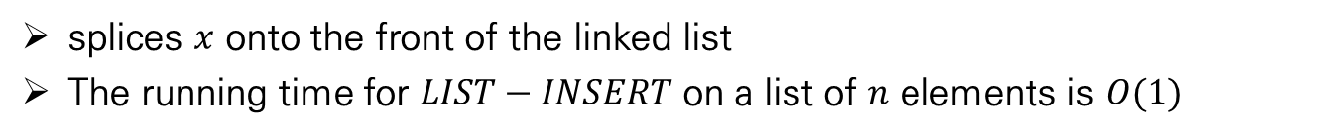
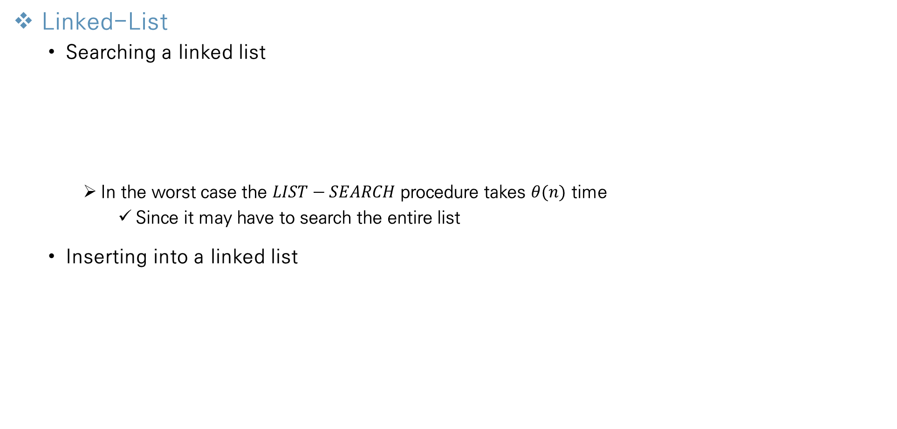
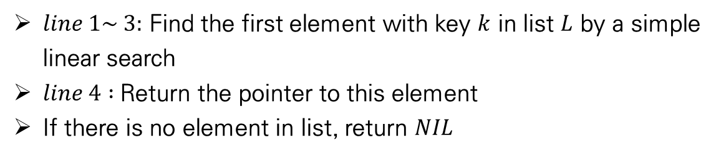
Elementary Data Structures
Linked-List
Searching a linked list
In the worst case the $LIST−SEARCH$ procedure takes $θ(n)$ time
Since it may have to search the entire list
Inserting into a linked list
$line 1\sim 3:$ Find the first element with key $k$ in list $L$ by a simple linear search
$line 4 :$Return the pointer to this element
If there is no element in list, return $NIL$
splices $x$ onto the front of the linked list
The running time for $LIST−INSERT$ on a list of $n$ elements is $O(1)$

Slide 10
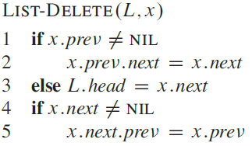
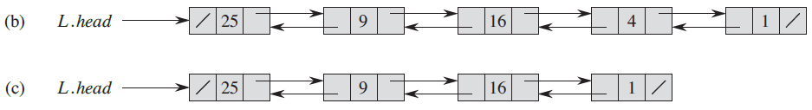
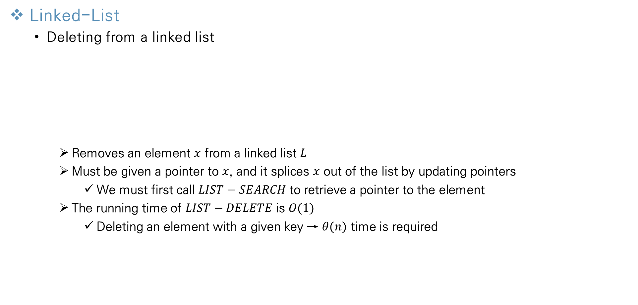
Elementary Data Structures
Linked-List
Deleting from a linked list
Removes an element $x$ from a linked list $L$
Must be given a pointer to $x$, and it splices $x$ out of the list by updating pointers
We must first call $LIST−SEARCH$ to retrieve a pointer to the element
The running time of $LIST−DELETE$ is $O(1)$
Deleting an element with a given key → $θ(n)$ time is required

Slide 11
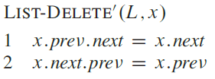
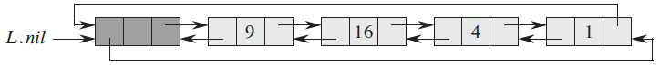
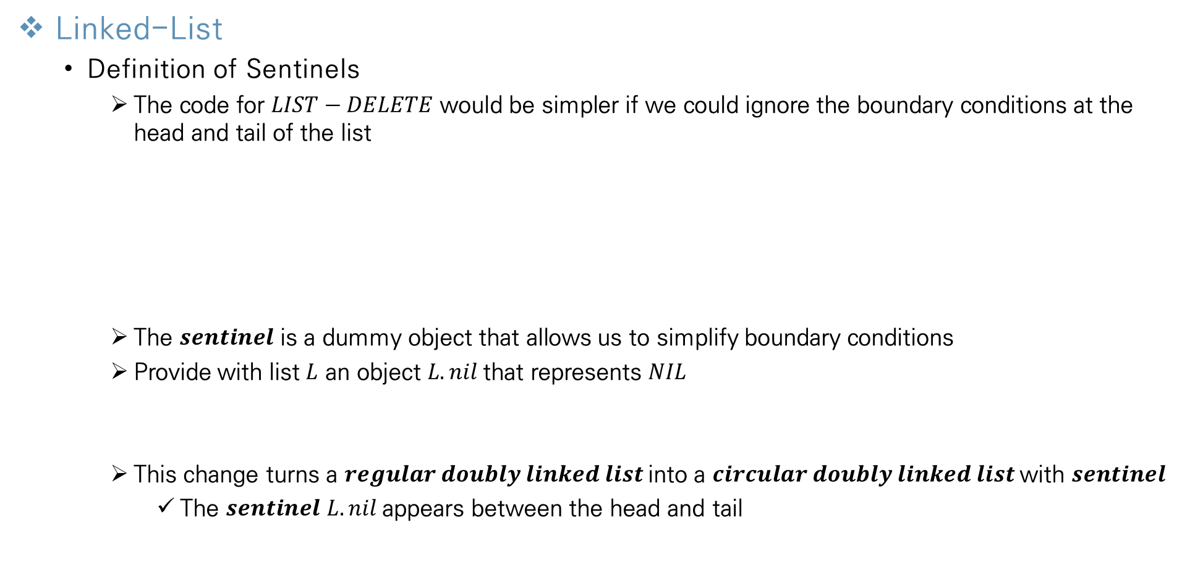
Elementary Data Structures
Linked-List
Definition of Sentinels
The code for $LIST−DELETE$ would be simpler if we could ignore the boundary conditions at the head and tail of the list
The $sentinel$ is a dummy object that allows us to simplify boundary conditions
Provide with list $L$ an object $L.nil$that represents $NIL$
This change turns a $regular doubly linked list$into a $circular doubly linked list$with $sentinel$
The $sentinel$ $L.nil$appears between the head and tail

Slide 12
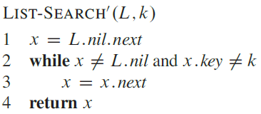
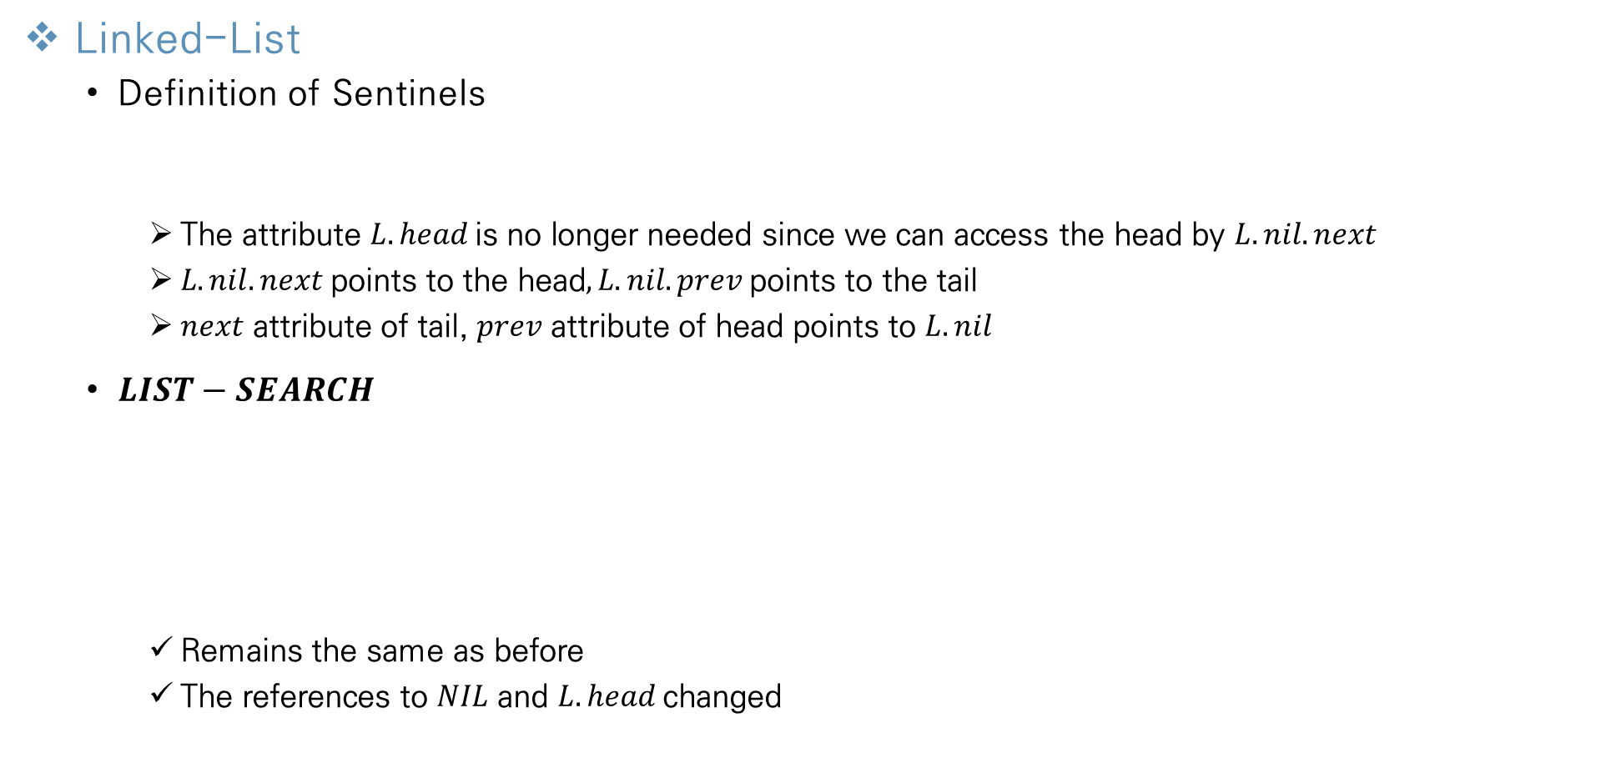
Elementary Data Structures
Linked-List
Definition of Sentinels
The attribute $L.head$is no longer needed since we can access the head by $L.nil.next$
$L.nil.next$points to the head$, L.nil.prev$points to the tail
$next$ attribute of tail, $prev$ attribute of head points to $L.nil$
$LIST−SEARCH$
Remains the same as before
The references to $NIL$ and $L.head$changed

Slide 13
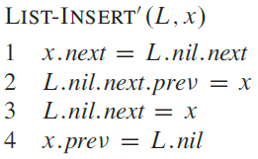
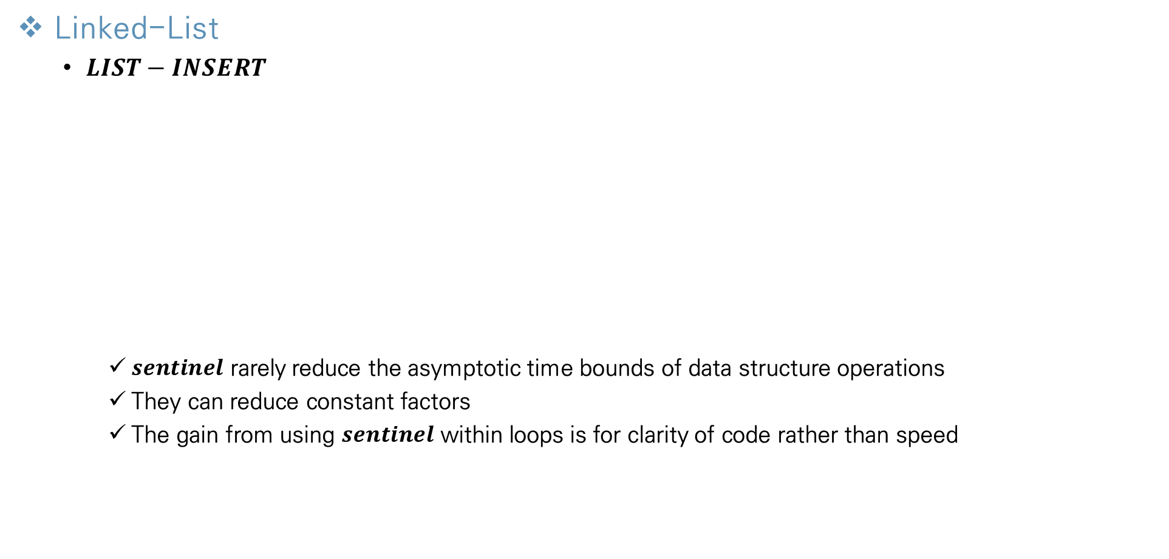
Elementary Data Structures
Linked-List
$LIST−INSERT$
$sentinel$ rarely reduce the asymptotic time bounds of data structure operations
They can reduce constant factors
The gain from using $sentinel$ within loops is for clarity of code rather than speed

Slide 14
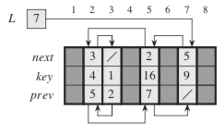
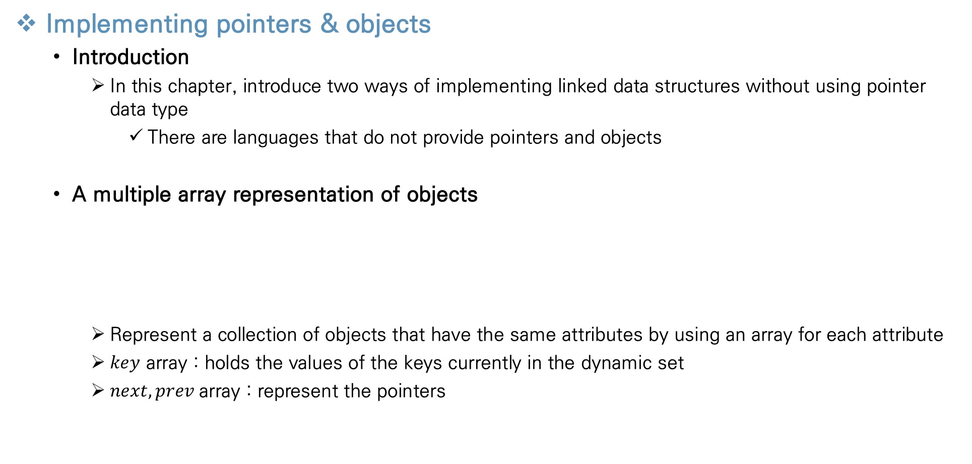
Elementary Data Structures
Implementing pointers & objects
Introduction
In this chapter, introduce two ways of implementing linked data structures without using pointer data type
There are languages that do not provide pointers and objects
A multiple array representation of objects
Represent a collection of objects that have the same attributes by using an array for each attribute
$key$ array : holds the values of the keys currently in the dynamic set
$next, prev$array : represent the pointers

Slide 15
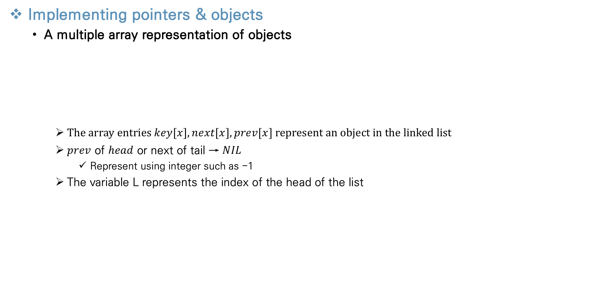
Elementary Data Structures
Implementing pointers & objects
A multiple array representation of objects
The array entries $key[x], next[x], prev[x]$represent an object in the linked list
$prev$ of $head$ or next of tail → $NIL$
Represent using integer such as -1
The variable L represents the index of the head of the list

Slide 16
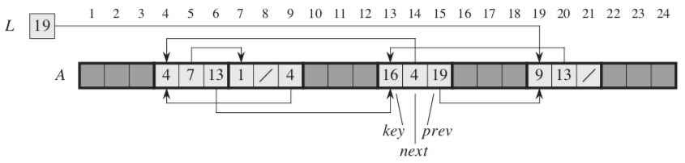
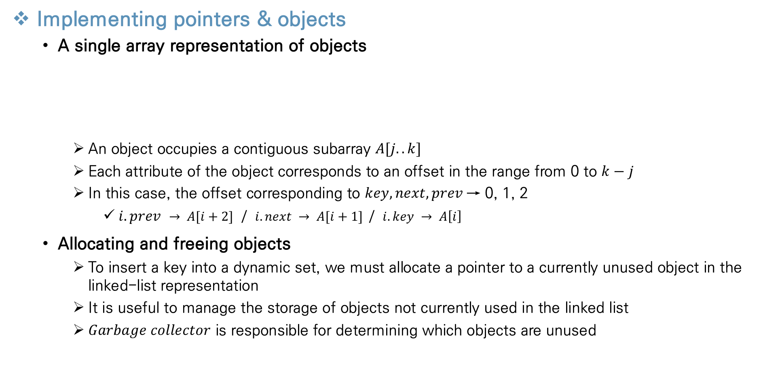
Elementary Data Structures
Implementing pointers & objects
A single array representation of objects
An object occupies a contiguous subarray $A[j..k]$
Each attribute of the object corresponds to an offset in the range from 0 to $k−j$
In this case, the offset corresponding to $key, next, prev$→ 0, 1, 2
$i.prev → A[i+2]$ / $i.next → A[i+1]$/ $i.key → A\left[i\right]$
Allocating and freeing objects
To insert a key into a dynamic set, we must allocate a pointer to a currently unused object in the linked-list representation
It is useful to manage the storage of objects not currently used in the linked list
$Garbage collector$ is responsible for determining which objects are unused
→ now explore the problem of allocating and freeing objects using $garbage collector$

Slide 17
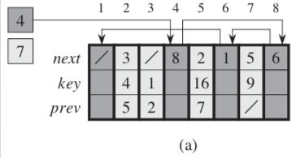
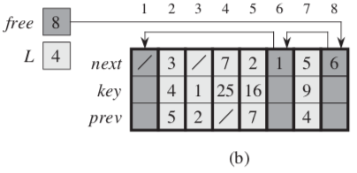
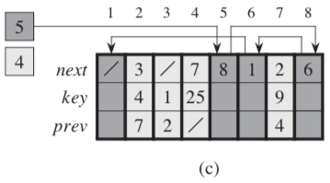
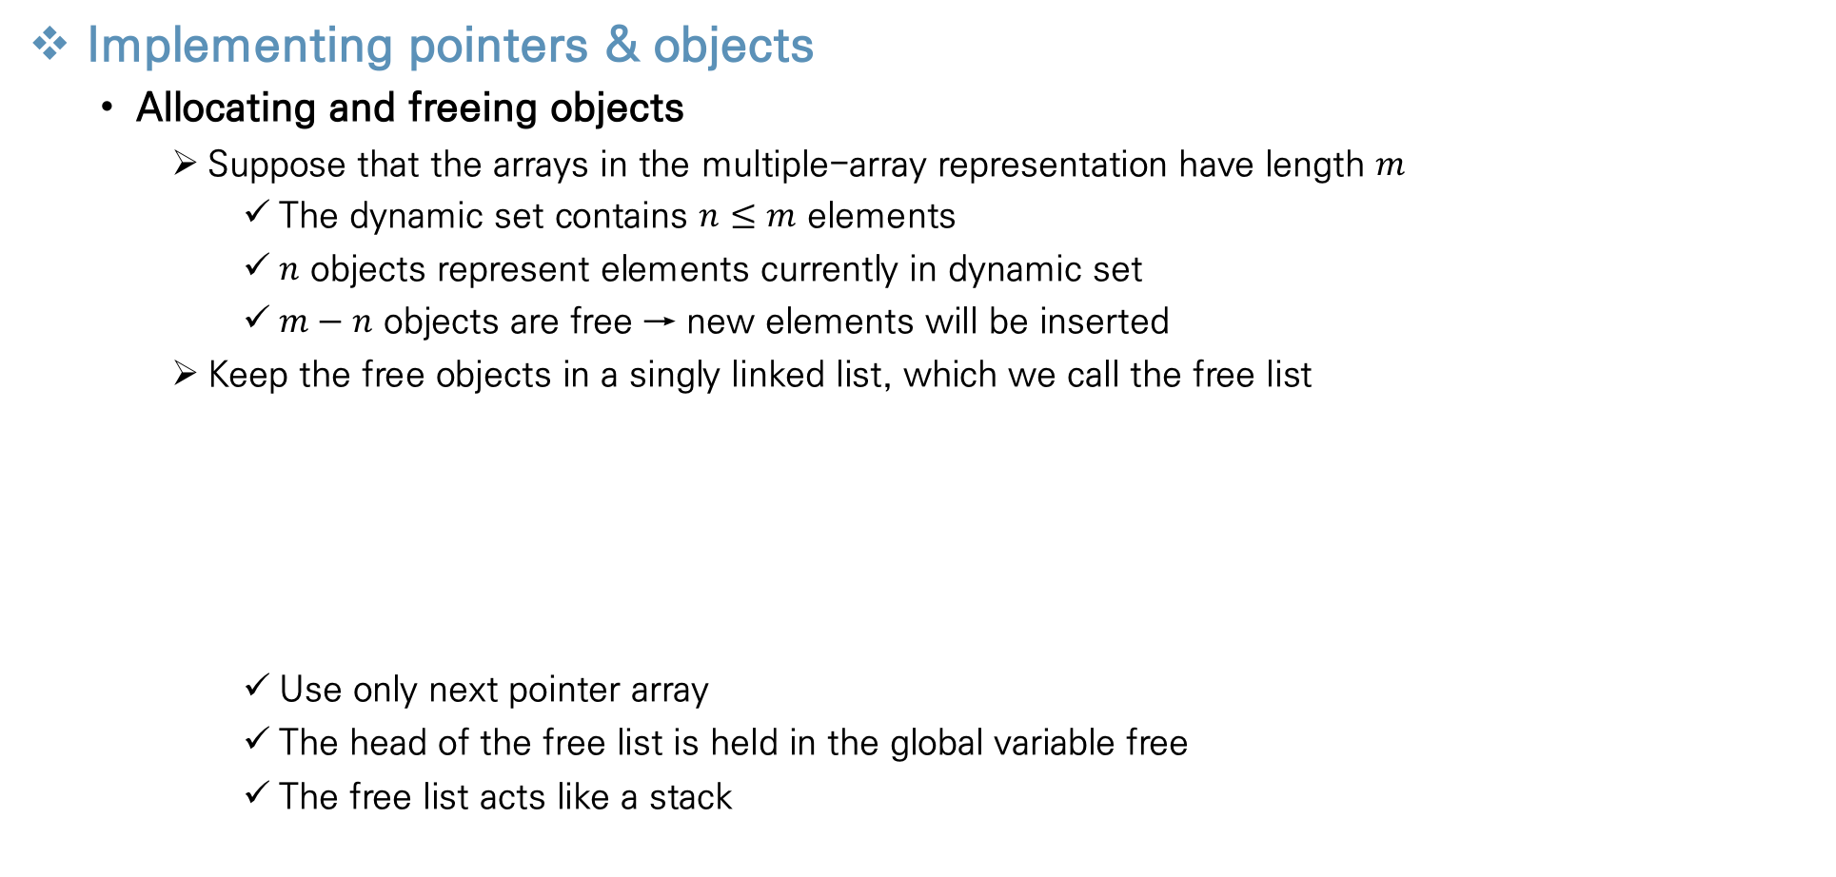
Elementary Data Structures
Implementing pointers & objects
Allocating and freeing objects
Suppose that the arrays in the multiple-array representation have length $m$
The dynamic set contains $n≤m$ elements
$n$ objects represent elements currently in dynamic set
$m−n$ objects are free → new elements will be inserted
Keep the free objects in a singly linked list, which we call the free list
Use only next pointer array
The head of the free list is held in the global variable free
The free list acts like a stack

Slide 18
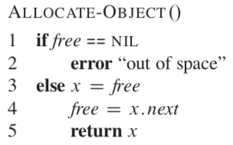
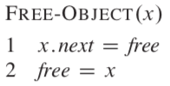
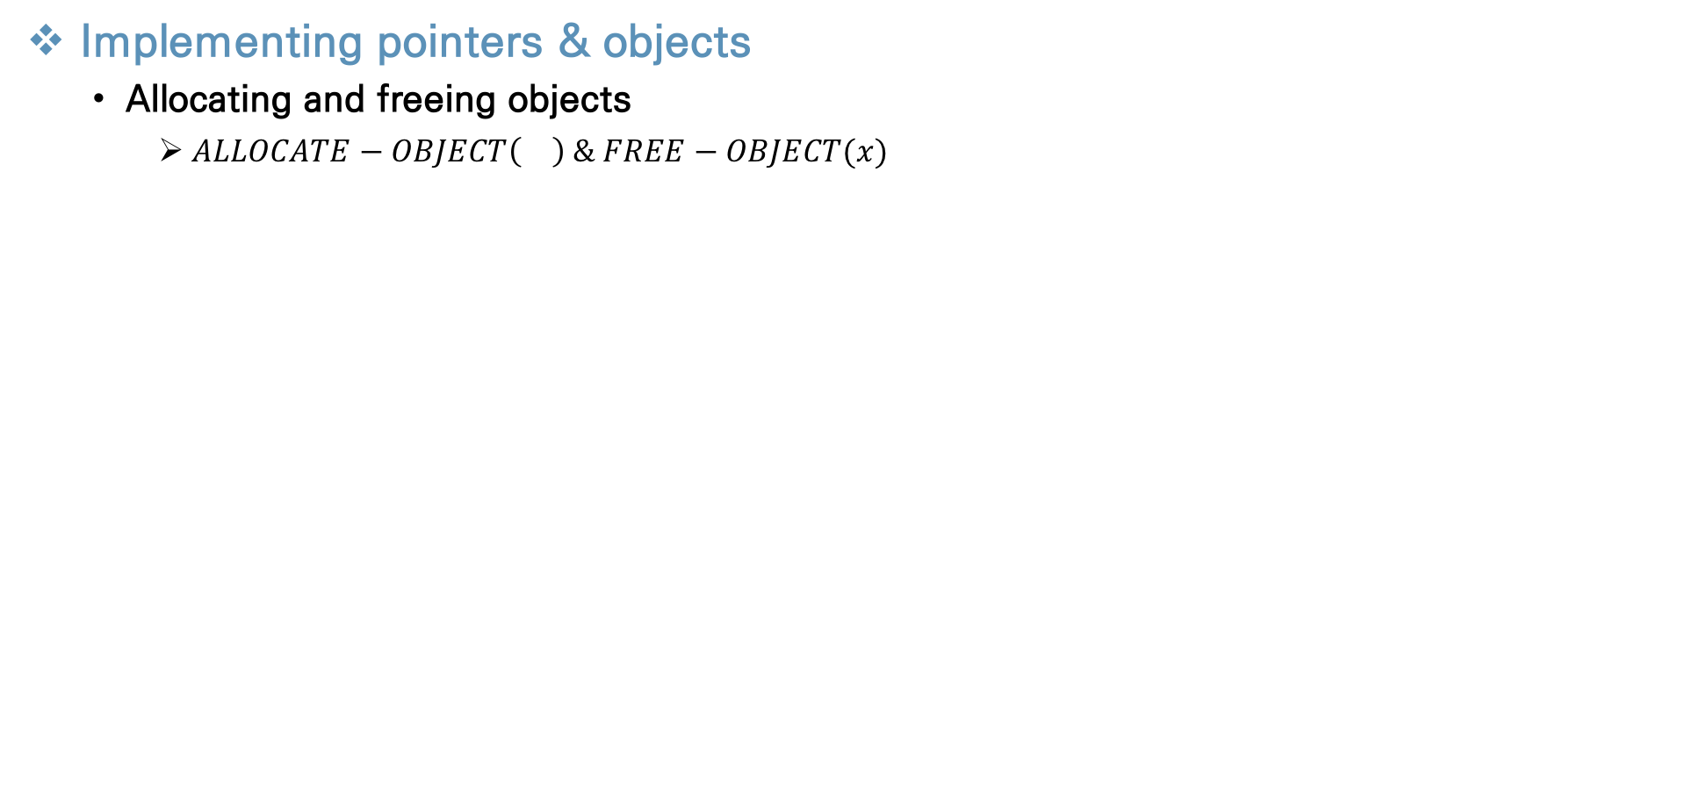
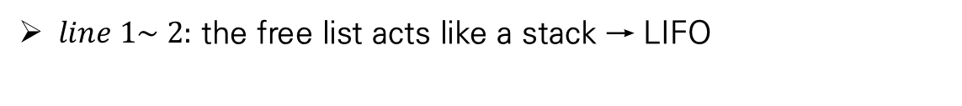
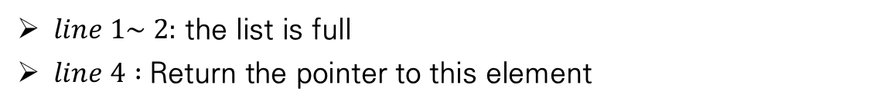
Elementary Data Structures
Implementing pointers & objects
Allocating and freeing objects
$ALLOCATE−OBJECT\left(\right) \& FREE−OBJECT(x)$
$line 1\sim 2:$ the list is full
$line 4 :$Return the pointer to this element
$line 1\sim 2:$ the free list acts like a stack → LIFO

Slide 19
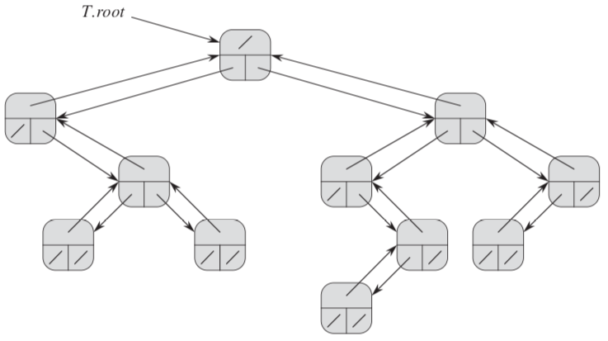
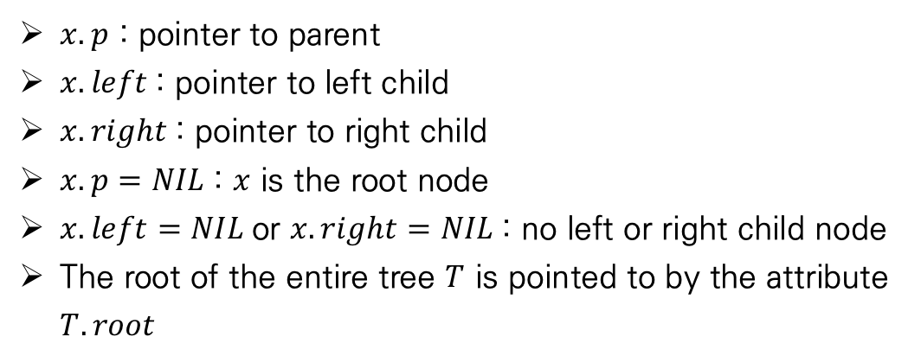
Elementary Data Structures
Representing Rooted Trees
Introduction
In this section, we look specifically at the problem of representing rooted trees by linked data structure
Represent each node of a tree by an object
Each node contains a key attribute
Pointer attribute are vary according to the type of tree
Binary tree
$x.p$ : pointer to parent
$x.left$: pointer to left child
$x.right$: pointer to right child
$x.p=NIL$: $x$ is the root node
$x.left=NIL$or $x.right=NIL$: no left or right child node
The root of the entire tree $T$ is pointed to by the attribute $T.root$

Slide 20




Elementary Data Structures
Representing Rooted Trees
Rooted trees with unbounded branching
There is a clever method to represent trees with only two pointers
if $x.left−child=NIL$: node x has no children
If $x.right−sibling=NIL$: node x is the rightmost child of its parents
Extend the method of a binary tree
The number of children of each node is at most some constant k
Replace the left and right attributes by $child_{1}, child_{2}, …, child_{k}$
It may waste memory space

Slide 21
Thank You!

